Slide 1


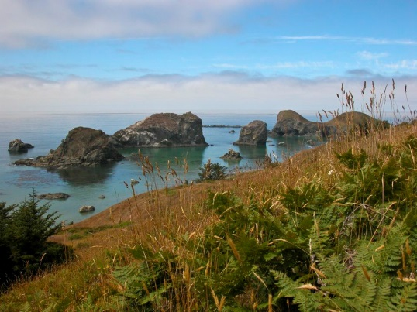

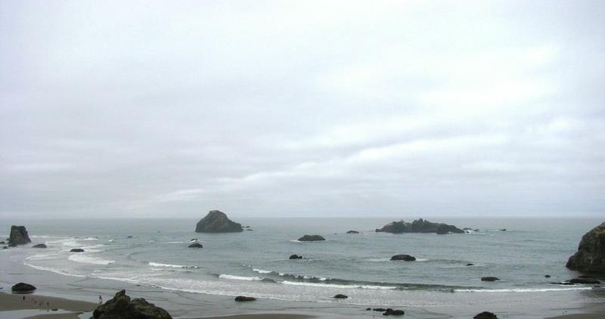
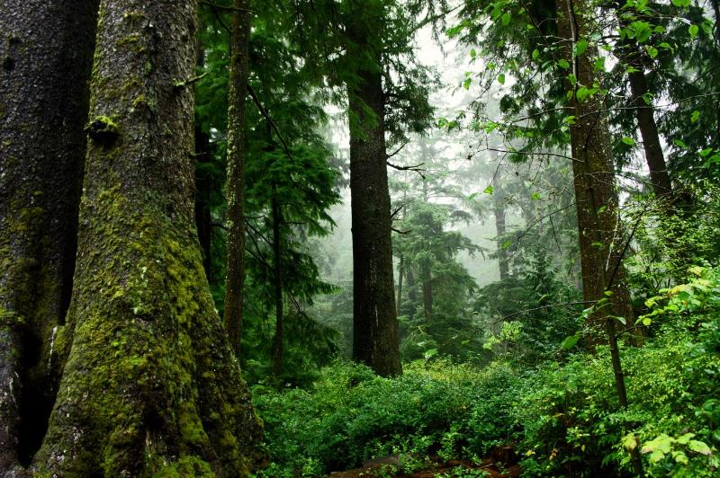
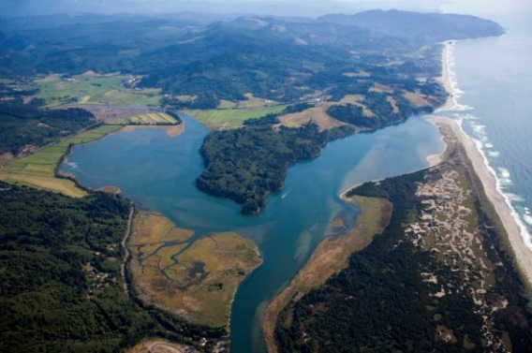
North Pacific LCC
Estuary Climate Change Workshop
USFWS Newport Field Office
November 13, 2014
John Mankowski – NPLCC

Slide 2
What are LCCs?
North Pacific LCC
  How we’re organized
  What we do

Slide 3

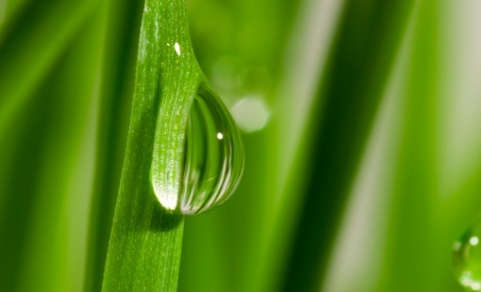
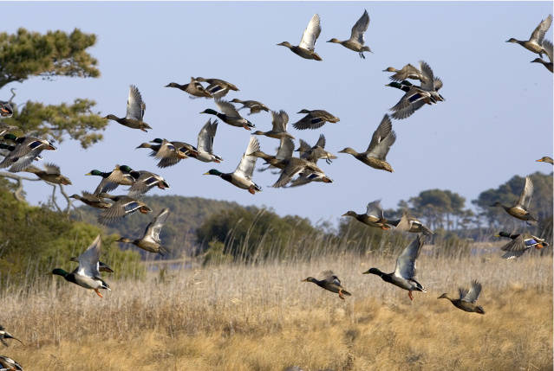
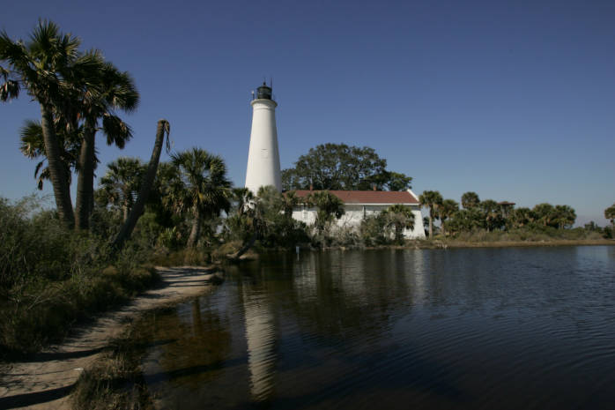

Collaborative conservation for future generations:
Landscape Conservation Cooperatives
lccnetwork.org

Slide 4

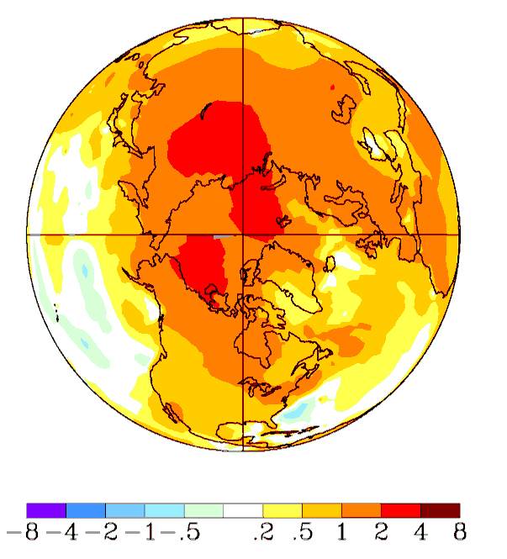
Our Challenges
Urban Growth
Habitat fragmentation
Genetic isolation
Invasive Species
Water Scarcity
Energy Development
Others…
All compounded by a rapidly changing climate
Temperature Change,° C
1958-2008
Notes:
These challenges will be compounded by continued growth, and growing affluence in human populations and the associated demands on land and water resources.
Our vision and our determination must be equal to these challenges.

Slide 5
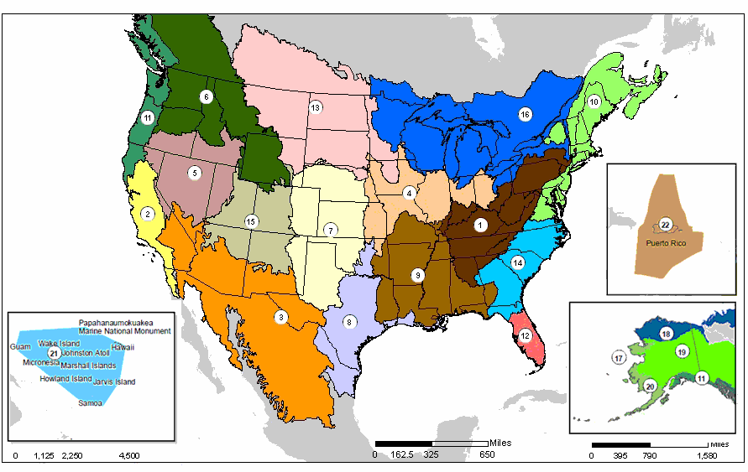
Landscapes Capable of Sustaining Natural and Cultural Resources for Current and Future Generations
Notes:
Collectively, the 22 LCCs are designed to be a seamless national network capable of supporting site-specific protection, restoration and management efforts to help natural systems across the continent.
LCCs coordinate across various programs and initiatives to jointly identify science and management priorities. Partner agencies coordinate with each other while working within their existing authorities and jurisdictions.

Slide 6

Involvement in the LCCs
250+ Agencies and Organizations
All 50 state natural resource agencies
  States serve as Chairs (or Vice Chairs) on ~2/3 LCC Steering Committees
All major federal resource management and conservation agencies
  FWS, BLM, BOR, NPS, USGS, BIA, BOEM
  USFS, NRCS, FSA, NOAA/NMFS, EPA, USACE, DOE, DOD, TVA
Tribes: 20+ individual and consolidated groups
NGOs, Partnerships (JVs, FHPs), Academic: 40+
Climate Science Centers
Notes:
Conservation organizations across the country have recognized the value in this approach and have joined the LCC endeavor. Basically every entity representing natural resources in some way is at the table. Emphasize state involvement and leadership in the LCCs.

Slide 7
LCC Network Organizational Structure
22 Individual LCCs
-Steering Committee
-Staff (coordinator, science)
-Technical Committees
LCC Network Ops
-National Staff
-LCC Coordinators Team
-Science Coordinators
-Executive Committees
-Work Groups
LCC Council
-Coordination & Strategic Guidance
-Federal; State; Tribal; NGO; LCCs; Major Partnerships; International

Slide 8

Landscape Conservation Cooperatives
Strategic Goals
A network of landscapes and seascapes adaptable to global change
Facilitated alignment of partnership needs
Conservation of natural and cultural resources guided by collaborative application of science, experience, and cultural and traditional ecological knowledge
Advance the knowledge of, support for, and engagement in landscape-scale conservation
Notes:
8

Slide 9

National Fish, Wildlife & Plants Climate Adaptation Strategy
Identified the LCC Network as a forum “to define, design, and deliver sustainable landscapes at a regional scale” including the development of “landscape/seascape scale plans capable of sustaining fish, wildlife, and plants.”

Slide 10

Who?
2 Countries
200+ Tribes and First Nations
4 States, 1 Province, 1 Territory
Where?
Entire range of Pacific Coastal Temperate Rainforest (>2,200 miles)
Terrestrial & Freshwater Aquatic Ecosystems
Adjacent Marine Ecosystems (shorelines, estuaries, nearshore)
78% public lands

Slide 11
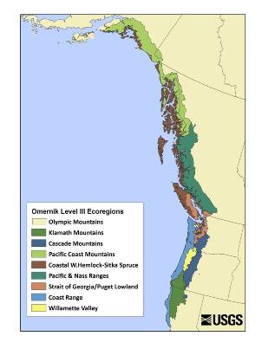
Features
Spans multiple agency, state, and international boundaries
Over more than 22 degrees of latitude
Wide range of type and intensity of human land-use activities
Alpine areas at the crest of coastal mountains across subalpine, montane, and lowland forests to the nearshore marine environment

Slide 12
Major Climate Issues
Marine Areas
  Oceans increasing in acidity
  Sea surface temperatures are rising
  Increased storm intensity, extreme wave heights, coastal erosion
  Rising sea levels, but the relative effect varies by location
  Increase in hypoxic events in the California Current
  Species range shifts, altered phenology, invasives, disease
  Food chain impacts, plankton die offs

Slide 13
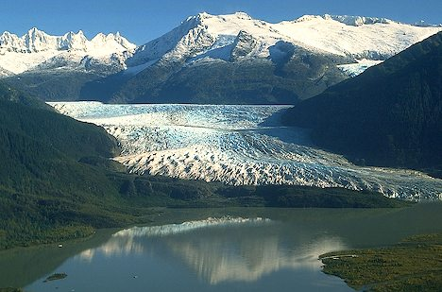
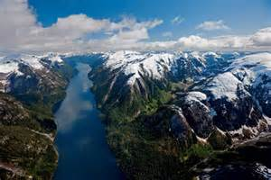
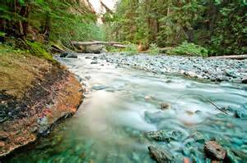
Major Climate Issues
On Land
  Annual average temperatures increasing
  Reduced snowpack, earlier snowmelt, more intense rain
  Increased frequency and size of landslides, windstorms, and avalanches
  Wetter winters; increased summer drought
  Increased growing seasons and frost-free periods
  Fire frequency and severity is increasing
  Invasives, pests, and disease:
    Spruce bark beetle, Swiss needle cast, sudden oak death
    Yellow-cedar decline is expanding
    Mountain pine beetle risk increasing
  Habitat loss and transition
  Species phenology, range shifts, and community composition.

Slide 14

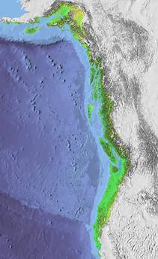
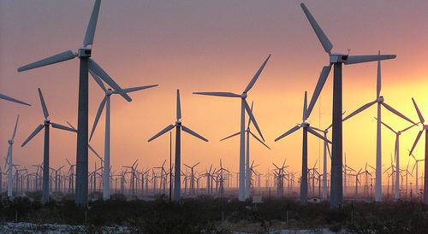
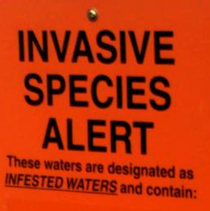
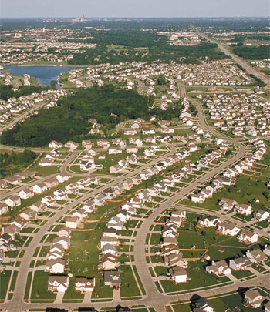
Other Challenges
Competing resource uses:
  Population growth, land use changes, energy development, many ESA listed species
Many sovereign entities with distinct priorities and authorities
Data and partnership rich in southern portions; how to add value, not confusion and duplication
Lack of baseline resource information in northern region
Fire hose challenges on climate and adaptation; need translation
Many distinct plans, processes, data sets…
… often built on outdated assumptions of a static environment

Slide 15
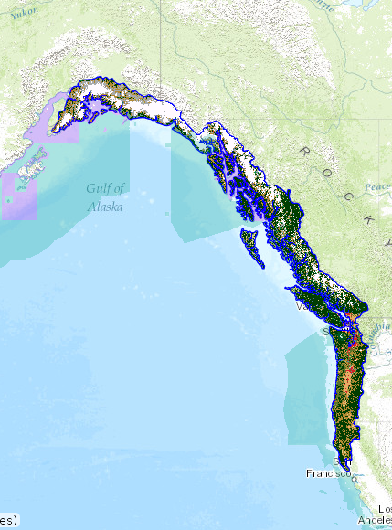
NPLCC Mission:
Promote development, coordination & dissemination of science
to inform landscape-level conservation & sustainable resource management
in the face of a changing climate and related stressors.
Notes:
If you need to leave out a slide – I recommend this one (or just briefly mention points here)
In FY 2012 – a focus was placed on funding TEK projects throughout the NPLCC. We hope to learn more about how and where TEK can be incorporated into NPLCC actions and management decisions. We may also need to update the Science/ TEK Strategy and the Implementation Plan based on lessons learned with these projects.
Currently on our website are draft reports that National Wildlife Federation prepared that compile literature and synthesize information about climate change effects and adaptation approaches for freshwater and for marine and coastal ecosystems in the entire range of the NPLCC. They are in the process of preparing a similar report for terrestrial habitats.
A cross –boundary data sharing workshop that will be held in Vancouver. B.C. was also supported. The Alaska Coastal Rainforest Center hosted the first two workshops and this third workshop will build on the past efforts.

Slide 16

Seven Goals:
Maximize ability resource managers make informed decisions given climate change and related stressors
Identify and address transboundary, landscape-level natural and cultural resource needs
Identify priorities for applied science and other information for conservation/sustainable resource management; coordinate efforts with science centers
Maximize availability and accessibility of data & information about large-scale stressors, impacts to natural & cultural resources, management options
Promote identification, use and sharing of science, traditional ecological knowledge, other relevant information
Promote coordination and efficiency of efforts
Promote awareness of effects climate change on environment, cultures, economies
Notes:
If you need to leave out a slide – I recommend this one (or just briefly mention points here)
In FY 2012 – a focus was placed on funding TEK projects throughout the NPLCC. We hope to learn more about how and where TEK can be incorporated into NPLCC actions and management decisions. We may also need to update the Science/ TEK Strategy and the Implementation Plan based on lessons learned with these projects.
Currently on our website are draft reports that National Wildlife Federation prepared that compile literature and synthesize information about climate change effects and adaptation approaches for freshwater and for marine and coastal ecosystems in the entire range of the NPLCC. They are in the process of preparing a similar report for terrestrial habitats.
A cross –boundary data sharing workshop that will be held in Vancouver. B.C. was also supported. The Alaska Coastal Rainforest Center hosted the first two workshops and this third workshop will build on the past efforts.

Slide 17
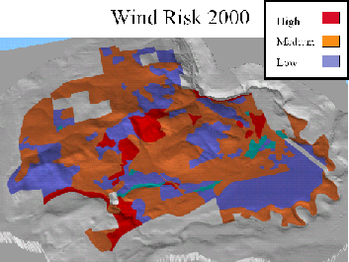

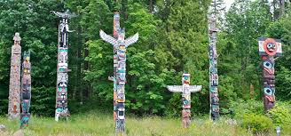
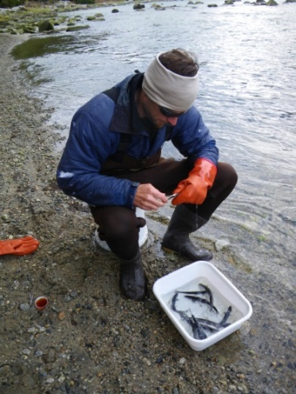
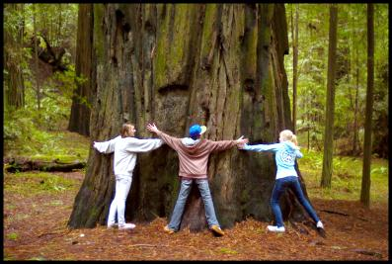

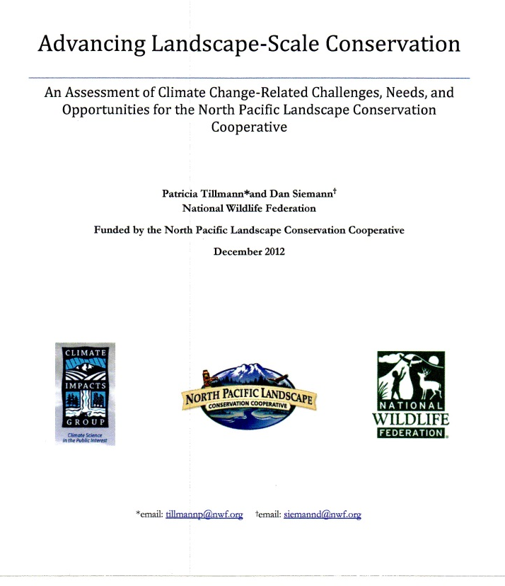
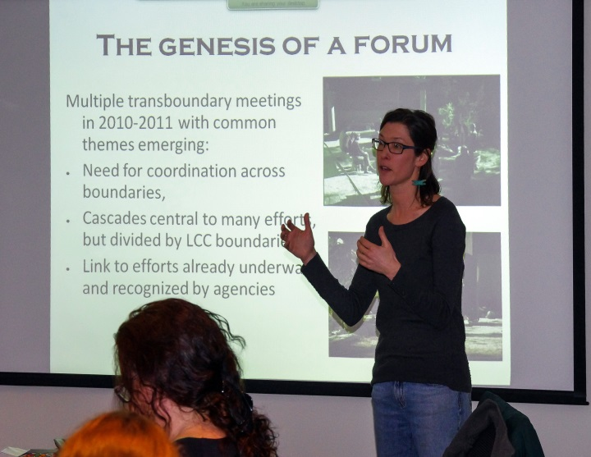
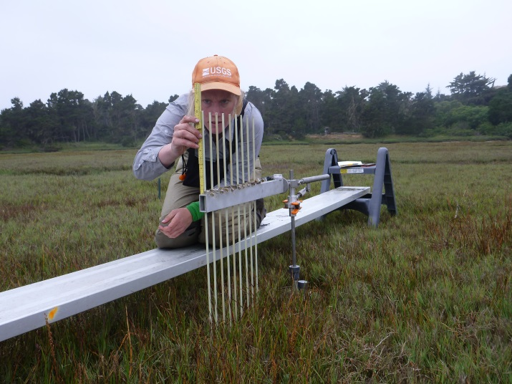
NPLCC Actions:
Convene Partners and Assess Needs
Fund Strategic Projects
Build Capacity
Communicate & Share Information

Slide 18
Steering Committee Entities
5 Tribes & First Nations
AK, BC, WA, OR, CA
State/Provincial
4 States (AK, WA, OR, CA)
British Columbia
Partnerships:
Pacific Coast J.V.
Science Orgs:
CSC (AK, NW, SW)
NOAA RISAs
Pac. Climate Impacts Con.
Federal
FWS, USFS, BLM, NOAA, NRCS, EPA, NPS, USGS, BIA
CWS, DFO
Notes:
If you need to leave out a slide – I recommend this one (or just briefly mention points here)
In FY 2012 – a focus was placed on funding TEK projects throughout the NPLCC. We hope to learn more about how and where TEK can be incorporated into NPLCC actions and management decisions. We may also need to update the Science/ TEK Strategy and the Implementation Plan based on lessons learned with these projects.
Currently on our website are draft reports that National Wildlife Federation prepared that compile literature and synthesize information about climate change effects and adaptation approaches for freshwater and for marine and coastal ecosystems in the entire range of the NPLCC. They are in the process of preparing a similar report for terrestrial habitats.
A cross –boundary data sharing workshop that will be held in Vancouver. B.C. was also supported. The Alaska Coastal Rainforest Center hosted the first two workshops and this third workshop will build on the past efforts.

Slide 19
2013-2016 Science & TEK Strategy
 | Climate-related drivers
Valued resources
Priority Topics
Effects of hydrologic regime shifts on rivers, streams, and riparian corridors
Effects of change in air temperature and precipitation on forests
Effects of changes in sea levels and storms on marine shorelines, the nearshore and estuaries
Effects of the changes in the hydrologic regime on anadromous fish
Invasive species, diseases, pests and their effects on biological communities
Evaluation
Criteria
Notes:
The Science/TEK Strategy includes Key parts - Guiding Principles and Priority Topics
Guiding Principles:
They are not ties to specific Priority Topics but encompass a variety of approaches that can be used to address an identified information or support gap.
They will be important in the annual planning work
The first guiding principle recognizes the importance of the NPLCC assisting with the development of adaptation and mitigation response actions and having a direct management link.
The second strategy recognizes the large amount of data and information that already exists and the need for the NPLCC to facilitate coordination, collaboration, capacity building, and developing tools for decision-makers, versus focusing on new data collections.
TEK is recognized as equally important as western science. The NPLCC will help identify and promote opportunities to use TEK where desired by Tribes and First Nations.
The NPLCC has a large number of different ecosystems and addressing the connections and interactions is important.
Priority Topics:
The first 3 Priority Topics focus in the NPLCCs three general ecosystems – freshwater/riparian, marine/coastal, and forests
Anadromous fish were selected as a priority topic because of their cultural and economic importance
The last priority topic focuses on invasive species, diseases, pests and their effects on biological communities in all the ecosystems.

Slide 20
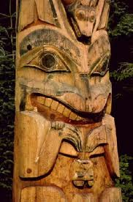
4-year Science & TEK Strategy
Guiding Principles
Focus availability and effectiveness of climate change adaptation and mitigation response actions
Focus facilitating coordination, collaboration, capacity building, and developing or assisting with tools for decision-makers
Identify and promote opportunities to use Traditional Ecological Knowledge
Promote and facilitate consideration of connections and interactions between ecosystems
Notes:
The Science/TEK Strategy includes Key parts - Guiding Principles and Priority Topics
Guiding Principles:
They are not ties to specific Priority Topics but encompass a variety of approaches that can be used to address an identified information or support gap.
They will be important in the annual planning work
The first guiding principle recognizes the importance of the NPLCC assisting with the development of adaptation and mitigation response actions and having a direct management link.
The second strategy recognizes the large amount of data and information that already exists and the need for the NPLCC to facilitate coordination, collaboration, capacity building, and developing tools for decision-makers, versus focusing on new data collections.
TEK is recognized as equally important as western science. The NPLCC will help identify and promote opportunities to use TEK where desired by Tribes and First Nations.
The NPLCC has a large number of different ecosystems and addressing the connections and interactions is important.
Priority Topics:
The first 3 Priority Topics focus in the NPLCCs three general ecosystems – freshwater/riparian, marine/coastal, and forests
Anadromous fish were selected as a priority topic because of their cultural and economic importance
The last priority topic focuses on invasive species, diseases, pests and their effects on biological communities in all the ecosystems.

Slide 21
Draft S-TEK Strategy Implementation Plan: 2015
Note: All NPLCC-funded activities should have management application and broader implications or lessons
Data and information sharing and synthesis
Support the use of vulnerability assessments / resilience studies in adaptation planning and implementation
Conduct, support, or facilitate landscape-scale conservation planning exercise(s) in a particular geography or region
Improve information on how climate change and associated adaptation actions will affect linkages between ecological and human resources
Expect RFP out beginning of December for Pre-proposals
Notes:
Interest and obligation in making sure some of the service’s objectives and goals are met
For example talked last week how SLR work we advocate for or fund can meet info needs of Mig birds
Want same conversations with other Service programs.
Want to see where can do work that meets both of our needs.

Slide 22
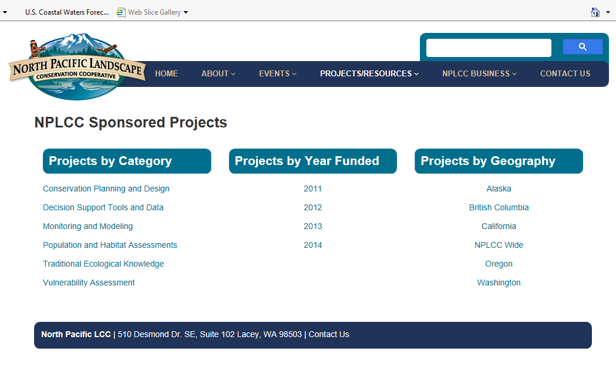
Over 50 Projects Funded
~$2 M invested

Slide 23
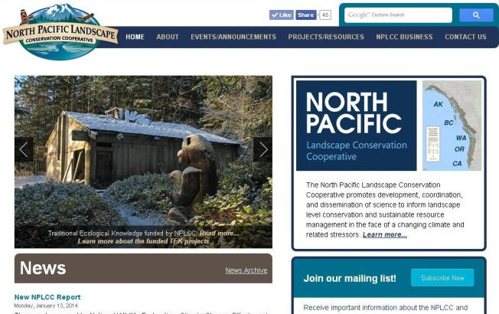

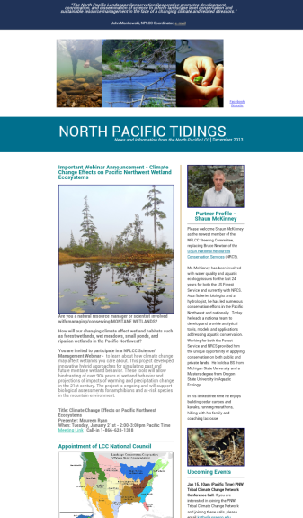


Communicate & Share Information
Website
Conservation Planning Atlas
Science/Management Webinars
Newsletters
  Climate Science Digest
  North Pacific Tidings
Social Media
  Facebook, Twitter, YouTube
Conferences/workshops/trainings
  NorthPacificLcc.org

Slide 24
John Mankowski – Coordinator
Mary Mahaffy – Science Coordinator
Meghan Kearney – Communication
Specialist
Tom Miewald – Data Coordinator
Jill Hardiman – Assistant Science Coord,
  NorthPacificLcc.org

Slide 25
Today
  Sea-Level Rise Modeling Along Pacific Coast –
  Tools, data, models for estuary, tidal, resources mangers
  Anticipate changes, understand new information, plan for change
  Jointly funded by NPLCC, CALCC, NW CSC

